Slide 1
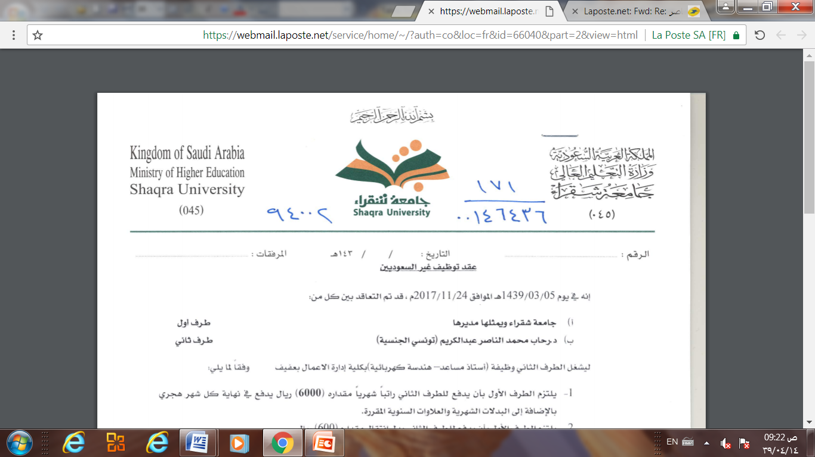
Database Management system
Chapter 4 (Part 2)
Basic Structured Query Language
Dr. Rihab Mohamed Naceur ABDELKRIM
E-mail: rihab@su.edu.sa
2017 - 2018

Slide 2
Chapter Outline
1-SQL Data Definition and Data Types
2-Specifying Constraints in SQL
3- Basic Retrieval Queries in SQL
4-INSERT, DELETE, and UPDATE Statements
in SQL
5- Additional Features of SQL

Slide 3
3- Basic Retrieval Queries in SQL
3-1- The SELECT-FROM-WHERE Structure of Basic SQL Queries
3-2- Ambiguous Attribute Names, Aliasing, Renaming, and Tuple Variables
3-3- Unspecified WHERE Clause and Use of the Asterisk
3-4- Tables as Sets in SQL
3-5- Substring Pattern Matching and Arithmetic Operators
3-6- Ordering of Query Results

Slide 4
3- Basic Retrieval Queries in SQL
SQL has one basic statement for retrieving information from a database: the SELECT statement.
The SELECT statement is not the same as the SELECT operation of relational algebra, which we discuss in Chapter 6.
There are many options and flavors to the SELECT statement in SQL, so we will introduce its features gradually.

Slide 5
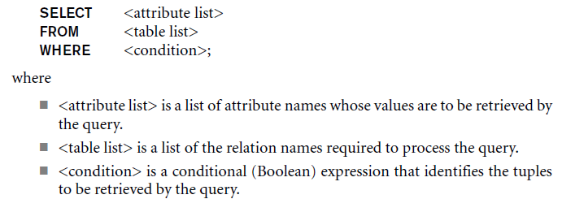
3- Basic Retrieval Queries in SQL
3-1- The SELECT-FROM-WHERE Structure of Basic SQL Queries
The basic form of the SELECT statement, sometimes called a mapping or a select-from-where block.
It is formed of the three clauses SELECT, FROM, and WHERE and has the following form:

Slide 6
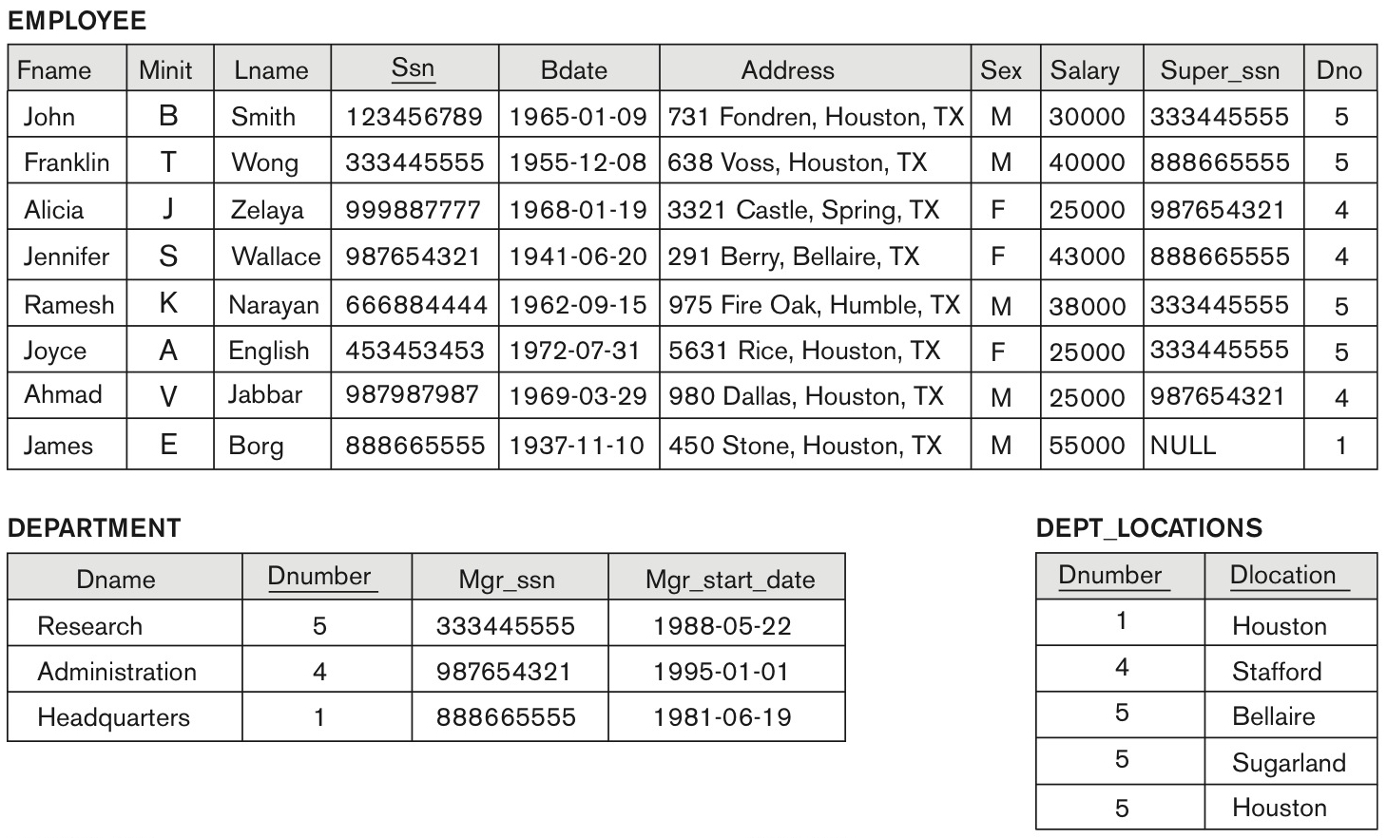
3- Basic Retrieval Queries in SQL
3-1- The SELECT-FROM-WHERE Structure of Basic SQL Queries
Example

Slide 7
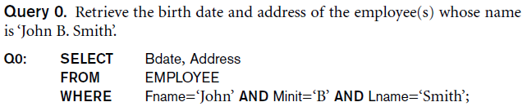
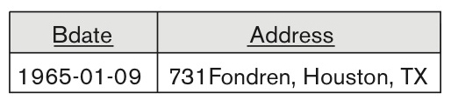
3- Basic Retrieval Queries in SQL
3-1- The SELECT-FROM-WHERE Structure of Basic SQL Queries
Example
Result

Slide 8
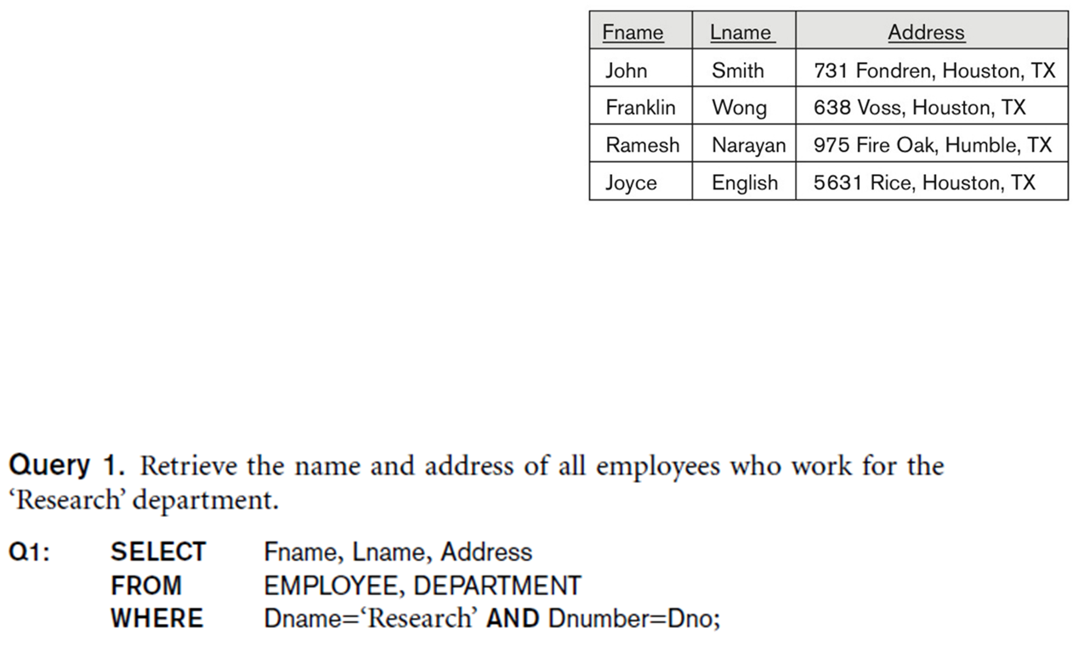
3- Basic Retrieval Queries in SQL
3-1- The SELECT-FROM-WHERE Structure of Basic SQL Queries
Example
Result

Slide 9
3- Basic Retrieval Queries in SQL
3-1- The SELECT-FROM-WHERE Structure of Basic SQL Queries
In the WHERE clause of Q1, the condition
Dname = ‘Research’ is a selection condition.
that chooses the particular tuple of interest in the DEPARTMENT table, because Dname is an attribute of DEPARTMENT.
The condition Dnumber = Dno is called a join condition, because it combines two tuples: one from DEPARTMENT and one from EMPLOYEE,
whenever the value of Dnumber in DEPARTMENT is equal to the value of Dno in EMPLOYEE.

Slide 10
3- Basic Retrieval Queries in SQL
3-2- Ambiguous Attribute Names
In SQL, the same name can be used for two (or more) attributes as long as the attributes are in different relations.
If this is the case, and a multitable query refers to two or more attributes with the same name, we must qualify the attribute name with the relation name to prevent ambiguity.
This is done by prefixing the relation name to the attribute name and separating the two by a period.

Slide 11

3- Basic Retrieval Queries in SQL
3-2- Ambiguous Attribute Names
Example

Slide 12
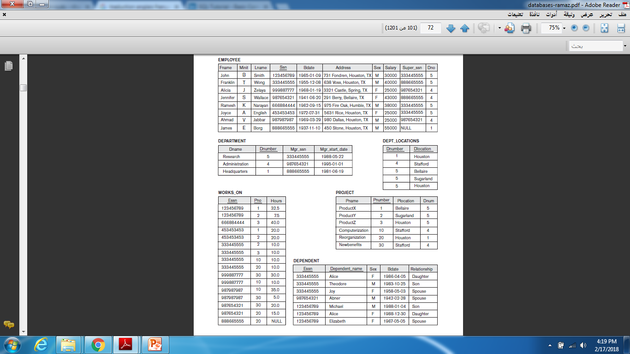
Example

Slide 13
3- Basic Retrieval Queries in SQL
3-2- Aliasing, and Renaming
Aliases or tuple variables
Declare alternative relation names E and S to refer to the EMPLOYEE relation twice in a query:
Query 8. For each employee, retrieve the employee’s first and last name and the first and last name of his or her immediate supervisor.
SELECT E.Fname, E.Lname, S.Fname, S.Lname
FROM EMPLOYEE AS E, EMPLOYEE AS S
WHERE E.Super_ssn=S.Ssn;
Recommended practice to abbreviate names and to prefix same or similar attribute from multiple tables.

Slide 14
3- Basic Retrieval Queries in SQL
3-2- Aliasing, and Renaming
The attribute names can also be renamed
EMPLOYEE AS E(Fn, Mi, Ln, Ssn, Bd, Addr, Sex, Sal, Sssn, Dno)
Note that the relation EMPLOYEE now has a variable name E which corresponds to a tuple variable
The “AS” may be dropped in most SQL implementations

Slide 15
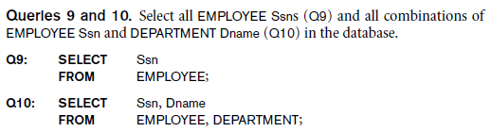
3- Basic Retrieval Queries in SQL
3-3- Unspecified WHERE Clause and Use of the Asterisk
Missing WHERE clause
Indicates no condition on tuple selection
Effect is a CROSS PRODUCT
Result is all possible tuple combinations (or the Algebra operation of Cartesian Product– see Ch.8) result

Slide 16
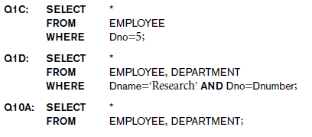
3- Basic Retrieval Queries in SQL
3-3- Unspecified WHERE Clause and Use of the Asterisk
Specify an asterisk (*)
Retrieve all the attribute values of the selected tuples
The * can be prefixed by the relation name;
e.g., EMPLOYEE *

Slide 17
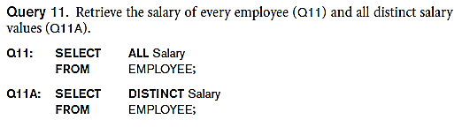
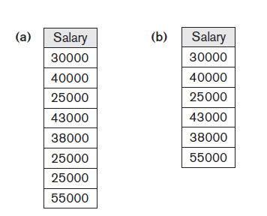
3- Basic Retrieval Queries in SQL
3-4- Tables as Sets in SQL
SQL does not automatically eliminate duplicate tuples in query results
Use the keyword DISTINCT in the SELECT clause
Only distinct tuples should remain in the result
Result

Slide 18
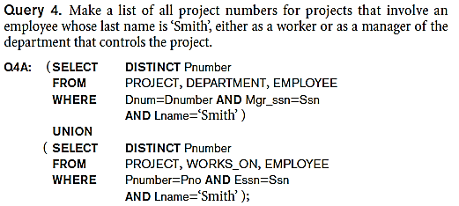
3- Basic Retrieval Queries in SQL
3-4- Tables as Sets in SQL
Set operations
UNION, EXCEPT (difference), INTERSECT
Corresponding multi set operations: UNION ALL, EXCEPT ALL, INTERSECT ALL)
Type compatibility is needed for these operations to be valid

Slide 19
3- Basic Retrieval Queries in SQL
3-5- Substring Pattern Matching and Arithmetic Operators
LIKE comparison operator
Used for string pattern matching
% replaces an arbitrary number of zero or more characters
underscore (_) replaces a single character
Examples:
WHERE Address LIKE ‘%Houston,TX%’;
WHERE Ssn LIKE ‘_ _ 1_ _ 8901’;

Slide 20
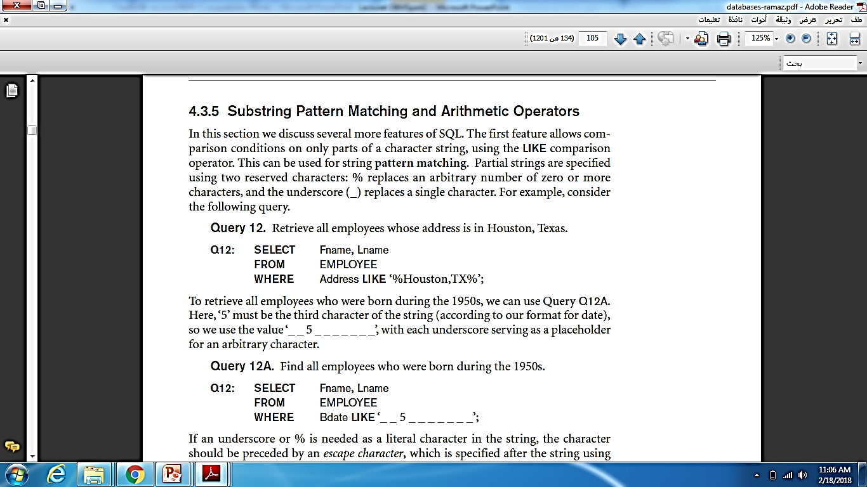
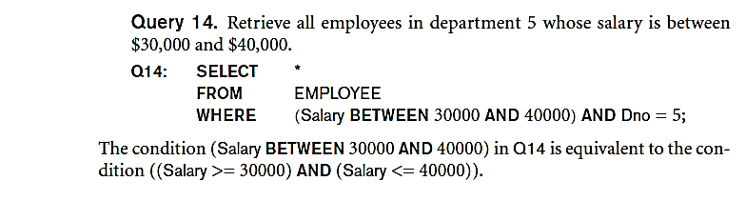
3- Basic Retrieval Queries in SQL
3-5- Substring Pattern Matching and Arithmetic Operators
BETWEEN comparison operator
E.g., in Q14 :

Slide 21
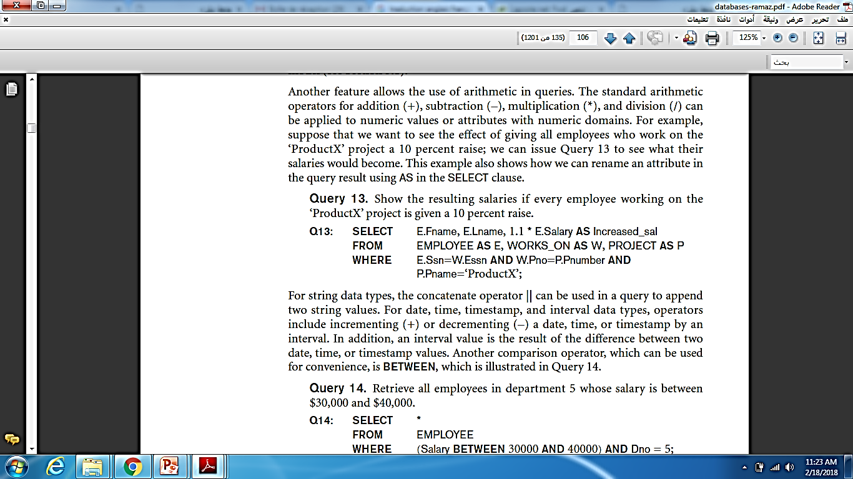
3- Basic Retrieval Queries in SQL
3-5- Substring Pattern Matching and Arithmetic Operators
Standard arithmetic operators:
Addition (+), subtraction (–), multiplication (*), and division (/) may be included as a part of SELECT

Slide 22
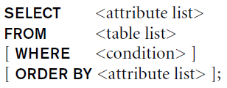
3- Basic Retrieval Queries in SQL
3-6- Ordering of Query Results
Use ORDER BY clause
Keyword DESC to see result in a descending order of values
Keyword ASC to specify ascending order explicitly
Typically placed at the end of the query
Example
Ordered alphabetically by last name, then first name.
ORDER BY D.Dname DESC, E.Lname ASC, E.Fname ASC

Slide 23
4-INSERT, DELETE, and UPDATE Statements
in SQL
4.1 The INSERT Command
4.2 The DELETE Command
4.3 The UPDATE Command

Slide 24
4-INSERT, DELETE, and UPDATE Statements
in SQL
Three commands used to modify the database:
INSERT, DELETE, and UPDATE
INSERT typically inserts a tuple (row) in a relation (table)
UPDATE may update a number of tuples (rows) in a relation (table) that satisfy the condition
DELETE may also update a number of tuples (rows) in a relation (table) that satisfy the condition

Slide 25
INSERT
In its simplest form, it is used to add one or more tuples to a relation
Attribute values should be listed in the same order as the attributes were specified in the CREATE TABLE command
Constraints on data types are observed automatically

Slide 26

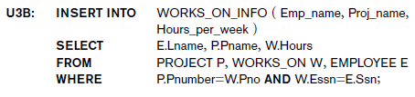
The INSERT Command
Specify the relation name and a list of values for the tuple. All values including nulls are supplied.
The variation below inserts multiple tuples where a new table is loaded values from the result of a query.
Example

Slide 27
DELETE
Removes tuples from a relation
Includes a WHERE-clause to select the tuples to be deleted
Referential integrity should be enforced
Tuples are deleted from only one table at a time (unless CASCADE is specified on a referential integrity constraint)
A missing WHERE-clause specifies that all tuples in the relation are to be deleted; the table then becomes an empty table
The number of tuples deleted depends on the number of tuples in the relation that satisfy the WHERE-clause

Slide 28
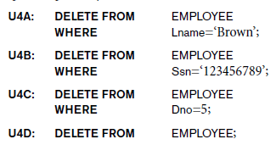
The DELETE Command
Removes tuples from a relation
Includes a WHERE clause to select the tuples to be deleted. The number of tuples deleted will vary.

Slide 29
UPDATE
Used to modify attribute values of one or more selected tuples
A WHERE-clause selects the tuples to be modified
An additional SET-clause specifies the attributes to be modified and their new values
Each command modifies tuples in the same relation
Referential integrity specified as part of DDL specification is enforced

Slide 30
UPDATE
Example:
Change the location and controlling department number of project number 10 to 'Bellaire' and 5, respectively.
U5: UPDATE PROJECT SET PLOCATION = 'Bellaire', DNUM = 5 WHERE PNUMBER=10

Slide 31

Techniques for specifying complex retrieval queries (see Ch.7)
Writing programs in various programming languages that include SQL statements: Embedded and dynamic SQL, SQL/CLI (Call Level Interface) and its predecessor ODBC, SQL/PSM (Persistent Stored Module) (See Ch.10)
Set of commands for specifying physical database design parameters, file structures for relations, and access paths, e.g., CREATE INDEX

Slide 32
Transaction control commands
Specifying the granting and revoking of privileges to users
Constructs for creating triggers
Enhanced relational systems known as object-relational define relations as classes. Abstract data types (called User Defined Types- UDTs) are supported with CREATE TYPE
New technologies such as XML (Ch.13) and OLAP are added to versions of SQL

Slide 33
Summary
SQL
A Comprehensive language for relational database management
Data definition, queries, updates, constraint specification, and view definition
Covered :
Data definition commands for creating tables
Commands for constraint specification
Simple retrieval queries
Database update commands

